Slide 1
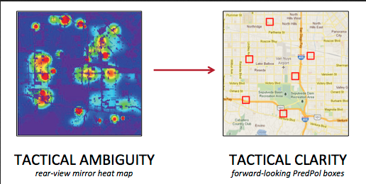
Predictive Policing
What is it and how does it work?
Predictive policing is the use of mathematical analytics by law enforcement to predict and respond to potential criminal activity.
Police apply statistical or machine learning algorithms to data from police records on the times, locations, and nature of past crimes, to look for potential patterns in when, where or what crimes may occur in the future.

Slide 2
Predictive Policing
What is it & how does it work?
Predictive policing methods generally fall into four categories:
methods for predicting crimes
methods for predicting offenders
methods for predicting potential perpetrators’ identities
methods for predicting victims of crime

Slide 3
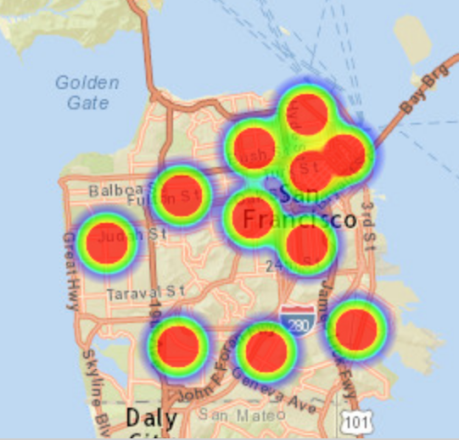
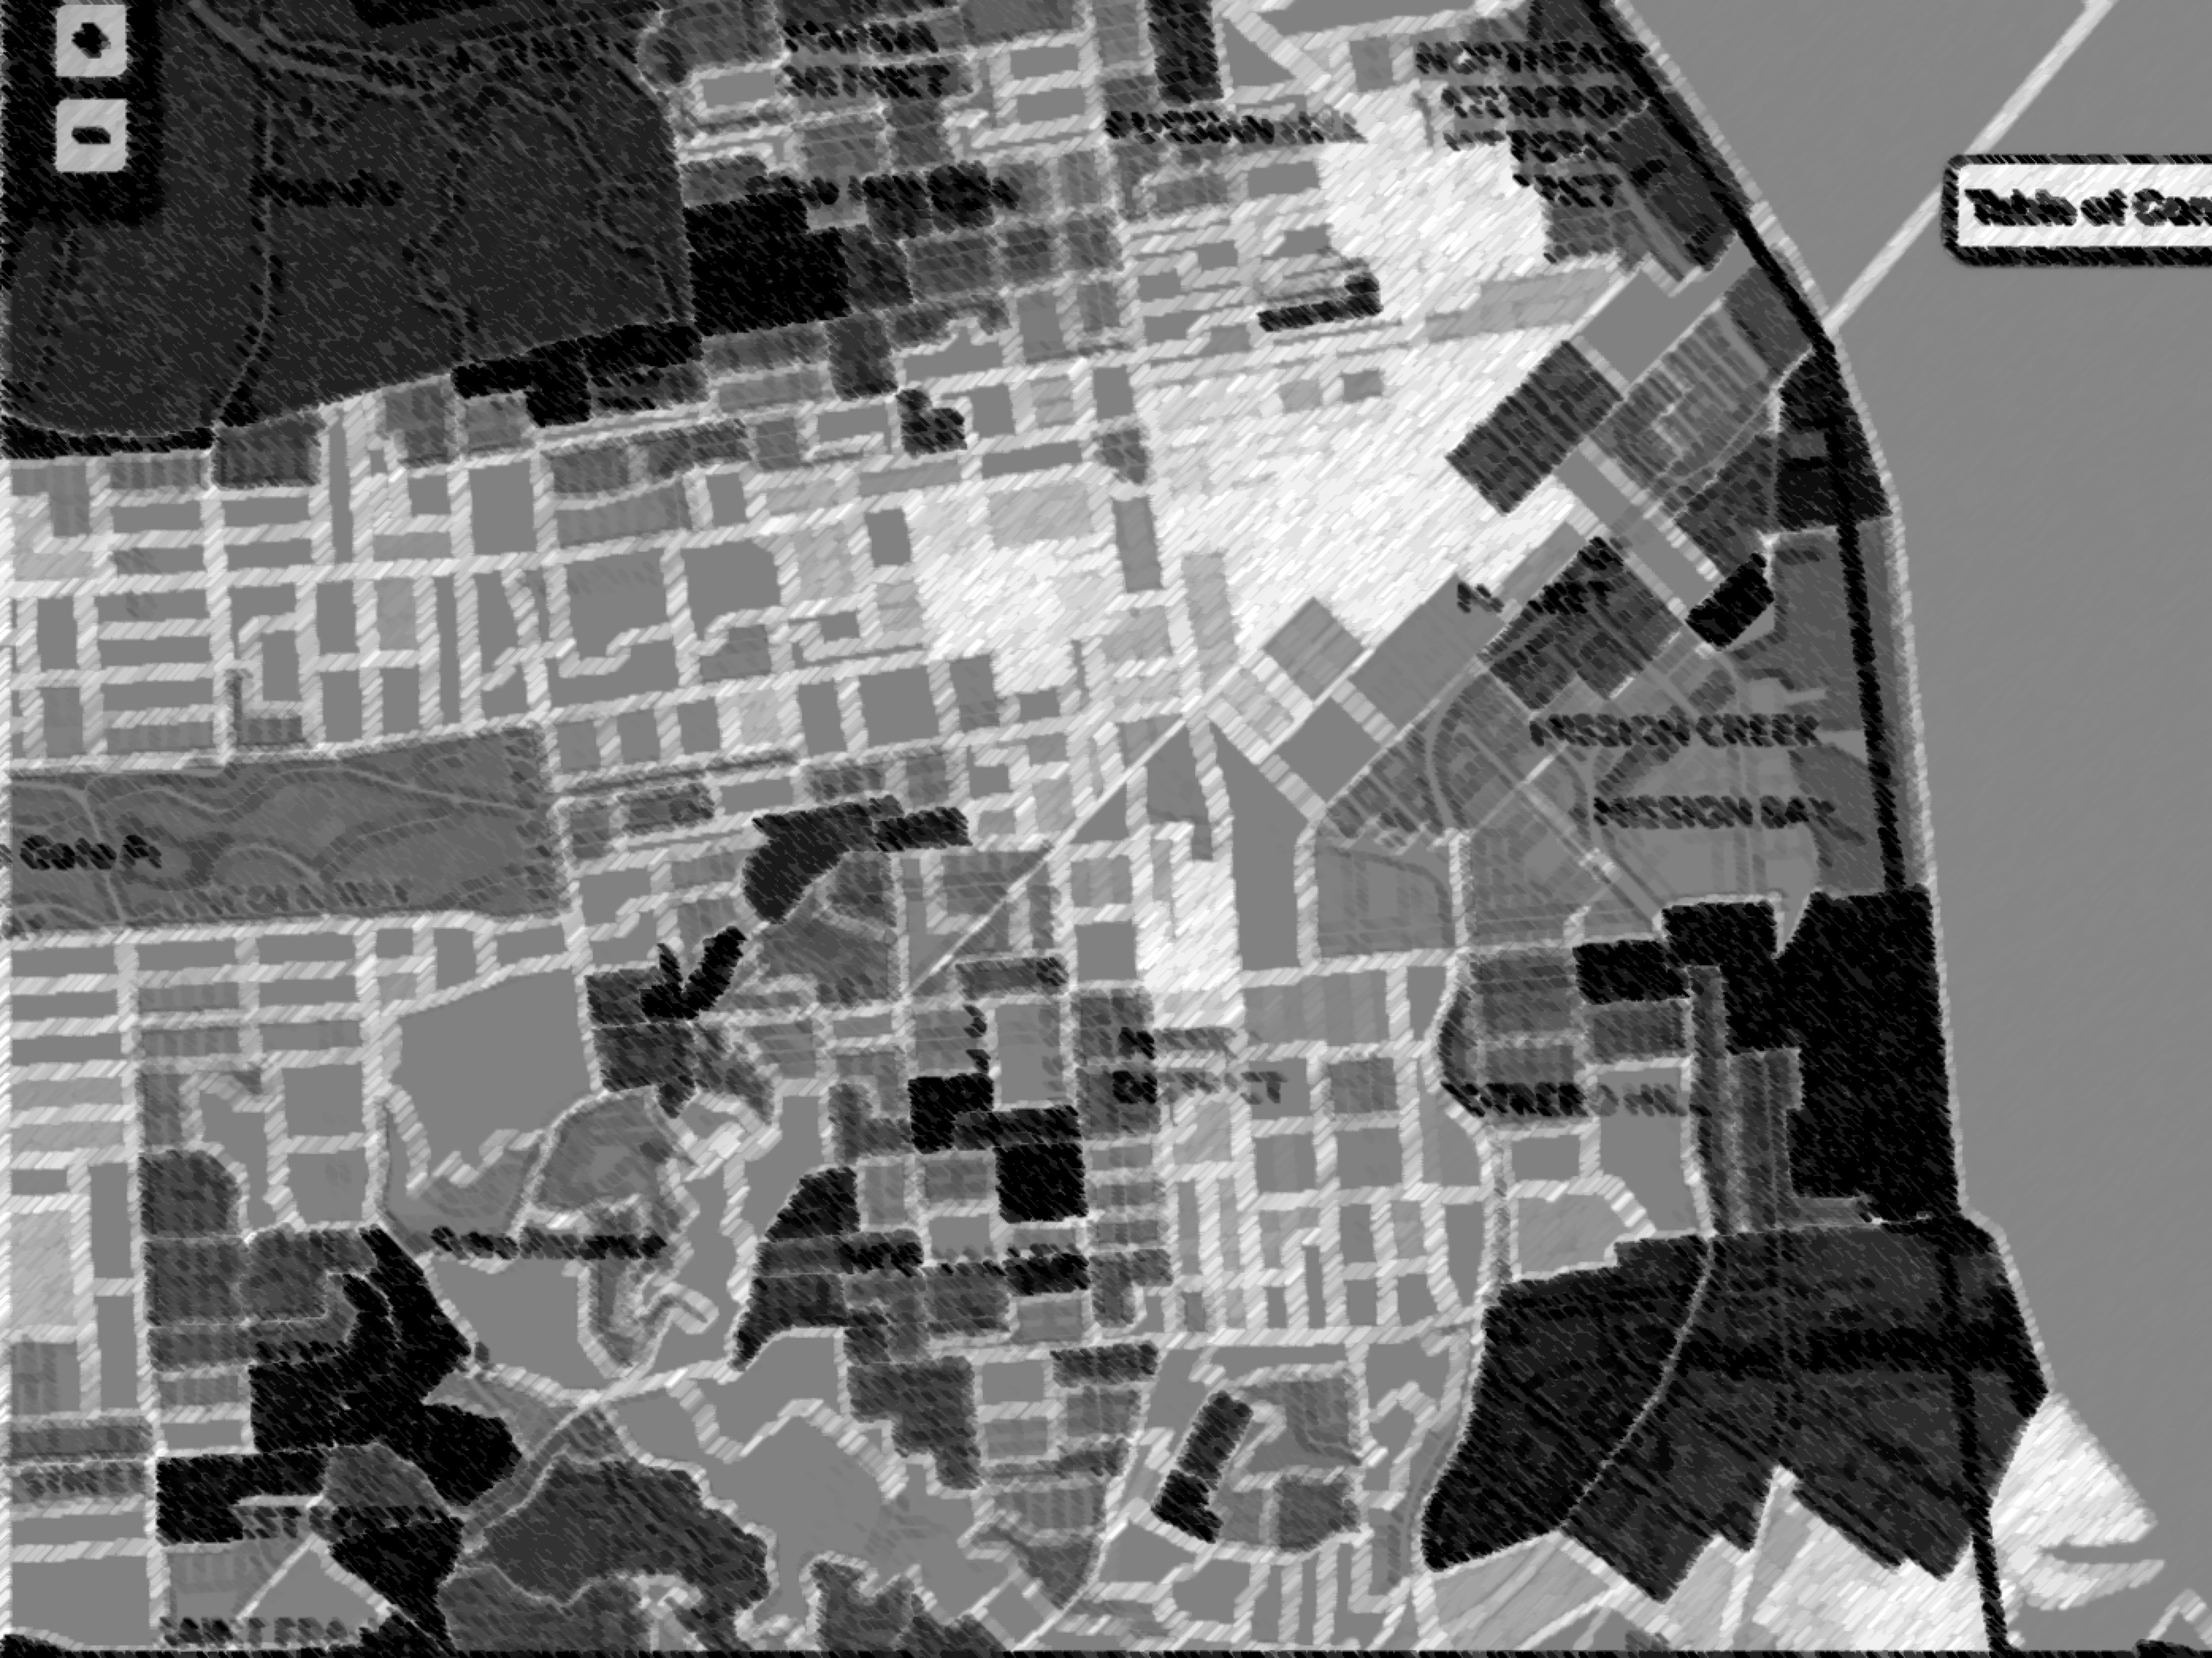
Predictive Policing Algorithms
What are the problems with predictive policing?
Systemic Bias - It amplifies racial disparities in policing by relying on patterns in police record keeping, not patterns in actual crime.
Data censoring/omission - Not all crimes and suspects are treated equally. Locations and communities that are heavily patrolled and recorded by police are over-represented in police records.
This leads to higher predictions of criminality for low-income communities of color that are disproportionately targeted, patrolled, and recorded by police.

Slide 4



Predictive Policing Algorithms
What are the problems with predictive policing?
It creates a technologically obscured tautology. The newly observed crimes are fed back into the algorithm to repeat the process of reinforcing the biases inherent in police practices.
It perpetuates a vicious cycle where police are sent to certain locations because the program predicts these locations to have the most crime, and the police convince themselves that these same locations have the most crime because these were the locations to which they were sent.

Slide 5
Predictive Policing Algorithms
How do I know if police are using a predictive policing program?
Specifically request discovery on the use of predictive policing software
Popular predictive policing programs to be on the lookout for:
Predpol - http://www.predpol.com/
Hunchlab - https://www.hunchlab.com/
Civicscape - https://www.civicscape.com/

Slide 6
Predictive Policing Algorithms
Oakland Case Study by Human Rights Data Analysis Group:
HRDAG looked at OPD’s recorded drug crimes and applied a predictive policing algorithm to assess where the algorithm suggested police look for future drug crimes.
They found that targeted policing would have been dispatched almost exclusively to lower income, minority neighborhoods because the majority of the drug crimes recorded by police were in these neighborhoods.

Slide 7
Predictive Policing Algorithms
Oakland Case Study by Human Rights Data Analysis Group:
But public health data on drug users combined with high resolution US Census data, showed that the distribution of drug users did not agree with the program’s predictions.
If this algorithm actually had been used with the goal of predicting and preventing crime in Oakland, it would have failed by sending police back into the communities they were already over-policing.

Slide 8
Predictive Policing Algorithms
How do I challenge predictive policing evidence?
Subpoena the contract between the police dept and predictive policing software developers to review limits in programming capabilities
Move to compel error rates and false positives.
Consider filing a motion to compel the program source code to search for flaws that may affect predictive search results.
Move to suppress evidence resulting from police use of biased data sets. (cite HDRAG study)

Slide 9

Predictive Policing
Examples of other predictive policing tools?
Public Safety Assessment (PSA) for bail release
COMPAS Assessment for PSR/sentencing
Bi-Analytics: Analyzes travel patterns for probationers/parolees
[Click on speaker link to play video]

Slide 10
Predictive Policing
How do I learn more?
Visit Human Rights Data Analysis Group: https://hrdag.org/policing/
HRDAG article on bias: https://eff.org/PPHRDAG
ACLU article on bias: https://eff.org/PPbias
RAND research report advocating for PP: https://eff.org/PPRAND [contains rubrics for how law enforcement justifies and brands PP]

Slide 11

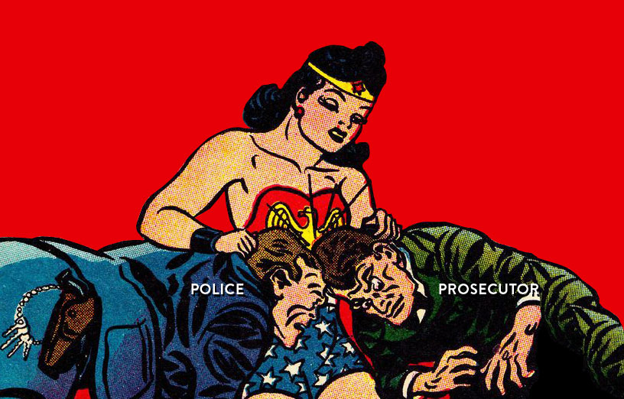
Stephanie Lacambra
Criminal Defense
Staff Attorney
415-436-9333 x130
stephanie@eff.org

