Slide 1

Government Malware
What is it and what does it do?
Malware is an abbreviation for “malicious software” specifically designed to gain access to or damage a computer without the owner’s consent.

Slide 2
Government Malware
How is it delivered?
Software is defined as malware based on the intent of the creator rather than on any specific features of the software or code.
A common vector for malware delivery is “spear phishing” – a highly targeted message, which attempts to trick a specific individual into revealing sensitive information or installing malware.
For an example, see the AP lawsuit over CIPAV – the government’s “Computer and IP Address Verifier” malware (eff.org/GMCIPAV)

Slide 3
Government Malware
What is a “NIT”?
“NIT” stands for “Network Investigative Technique”, a term used exclusively by the U.S. government to refer to the methods or tools it uses to access computers of individuals that have taken steps to obscure or mask certain identifying info, like an IP address.
“NIT” is a term coined by the FBI. It has no technical meaning. The FBI chose an acronym meant to minimize the appearance of intrusiveness of its tools.

Slide 4
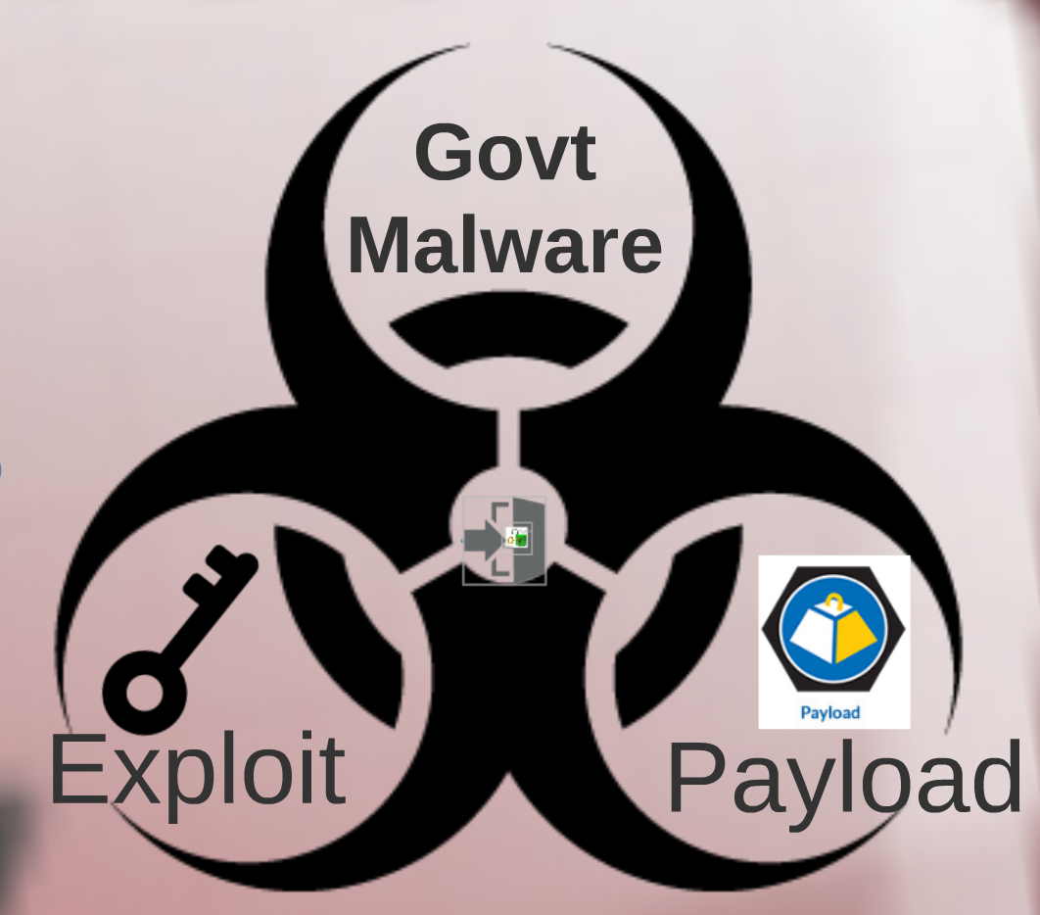
Government Malware
How does it work?
Malware is usually composed of at least two critical parts: the Exploit and the Payload.

Slide 5
Government Malware
How does it work?
Exploit - a piece of software, a chunk of data, or a sequence of commands that takes advantage of a vulnerability in order to cause unintended or unanticipated behavior to occur on computer software, hardware, or some other electronic device.
Such behavior frequently includes things like gaining control of a device, stealing private information, or a denial-of-service attack.

Slide 6

Government Malware
How does it work?
Payload - the part of the malware that performs actions chosen by the author or operator – usually to spy on a specific target – producing effects on or through the affected systems.

Slide 7
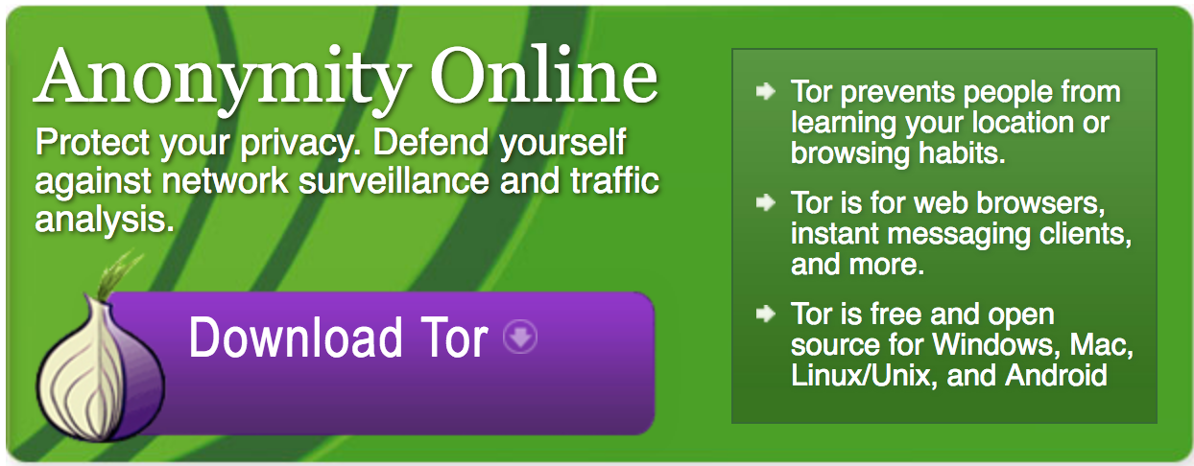

Government Malware
The Playpen Case Example
FBI used malware that was surreptitiously disseminated through a Tor hidden service.

Slide 8
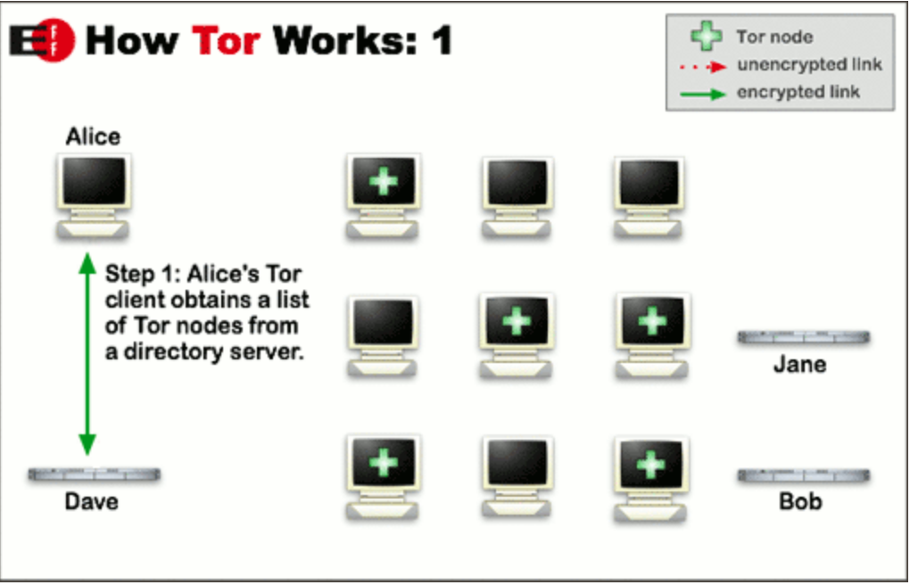
How Tor works:

Slide 9
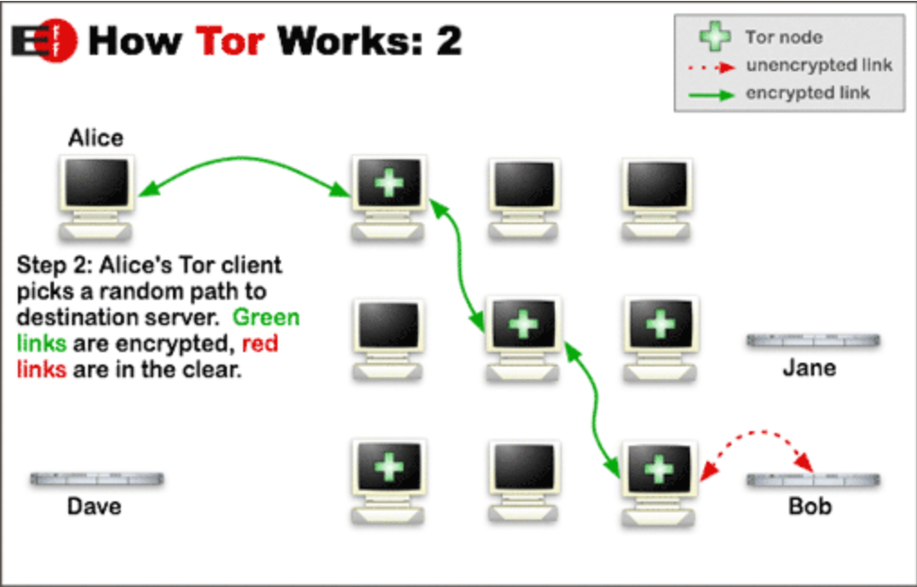
How Tor works:

Slide 10
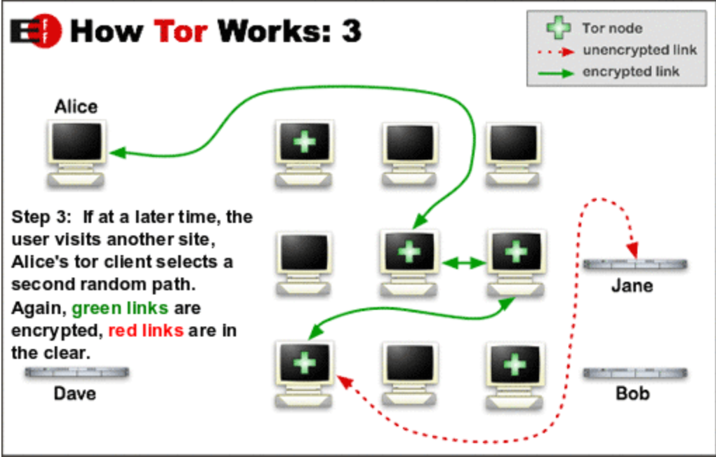
How Tor works:

Slide 11
Government Malware
The Playpen Case Example
The govt malware was designed to pierce the anonymity provided by the Tor network by exploiting a vulnerability in the Firefox web browser (running as part of the Tor Browser) to place computer code on users’ computers that would transmit private information back to a law enforcement server outside of the Tor network.

Slide 12
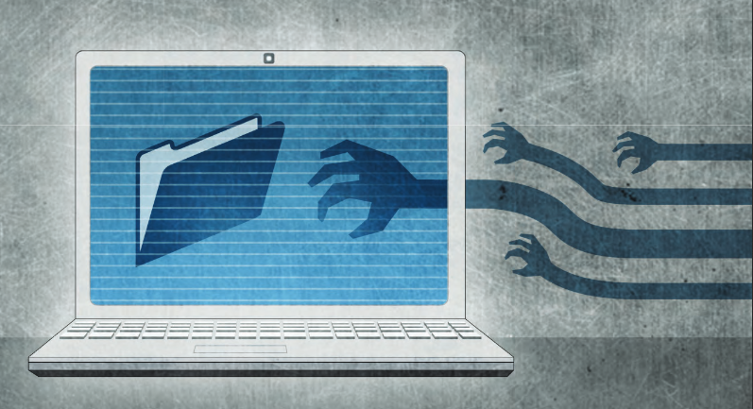
Government Malware
The Playpen Case Example
In the Playpen cases, the FBI indicated that the payload of the software that ran on users’ computers was designed and used to gather identifying information from those computers and transmit it back to the FBI unencrypted and unauthenticated via the Internet.

Slide 13
Government Malware
How do I challenge govt malware?
Some MTS arguments deployed by defense in the Playpen cases:
Single warrant violated Rule 41
Warrant failed particularity requirement of 4th Amendment
Move to compel the entire malware source code in order to evaluate for program flaws that could exculpate your client

Slide 14
Government Malware Cases
Helpful cases granting MTS, pre-FRE 41 change:
SD IA: US v. Croghan (209 F.Sup.3d 1080 (Sept 19, 2016))
D. CO: US v. Workman (209 F.Supp.3d 1256 (Sept 6, 2016))
ND OK: US v. Arterbury, (No. 15-cr-182, No. 42 (Apr 25, 2016)) https://eff.org/GMArterbury
D. Minn: US v. Carlson (2017 WL 1535995 (Mar 23, 2017))
D. Mass: US v. Levin (186 F. Supp.3d 26 (May 5, 2016))
SD TX: In re Warrant to Search a Target Computer at Premises Unknown (958 F.Supp.2d 753 (Apr 22, 2013))

Slide 15
Government Malware Cases
Cases finding Rule 41 violation, but upholding warrant:
ED MI: US v. Kahler (2017 WL 5886707 (Feb 14, 2017))
ED PA: US v. Werdene (188 F.Supp.3d 431 (May 18, 2016))

Slide 16
Government Malware Cases
Harmful cases denying MTS:
D. SC: US v. Knowles (207 F.Supp.3d 585 (Sept 14, 2016))
ED VA: US v. Matish (193 F.Supp.3d 585 (June 23, 2016))
ED WI: US v. Epich (2016 WL 953269 (Mar 16, 2016))
WD WA: US v. Michaud (2016 WL 337263 (Jan 28, 2016))

Slide 17
Government Malware
How do I learn more?
Review our joint report on how to challenge govt malware: eff.org/GMChallenge
For more on Playpen: eff.org/GMPlaypen
eff.org/GMPlaypenFAQ For why courts should disclose the exploit: https://eff.org/GMDiscloseExploit

Slide 18


Stephanie Lacambra
Criminal Defense
Staff Attorney
415-436-9333 x130
stephanie@eff.org

